Slide 1

SC1015 MINI PROJECT
UNDERSTANDING HAPPINESS
Oak Soe Khant
Sisodia Anushka
Oza Tirth Tusharbhai

Slide 2
TABLE OF CONTENTS
01
02
03
04
05
INTRODUCTION
EDA.IPYNB
CLEANING.IPYNB
MACHINE_LEARNING.IPYNB
STATISTICAL INFERENCE
Notes:
Explain the table of contents, make sure to mention that the notebooks are to be read in order

Slide 3
INTRODUCTION

Slide 4
PRACTICAL MOTIVATION
As a global society, we are waking up to the fact that happiness in our daily lives is extremely important.
In today’s world where data is available everywhere, a data-driven approach could allow for a better understanding of happiness factors. It would be plausible to determine the key aspects of well-being and quantify their impact to one's happiness.
We aim to help the governments and different policy makers to increase the well being of its citizens.
We can make use of “The World Happiness Report”, a publication of the United Nations Sustainable Development Solutions Network. It contains rankings of national happiness, based on respondents' ratings of their own lives, which also correlates with various quality of life factors.
Notes:
As a global society, we are waking up to the fact that happiness in our daily lives is extremely important.
In today’s world where data is available everywhere, a data-driven approach could allow for a better understanding of happiness factors. It would be plausible to determine the key aspects of well-being and quantify their impact to one's happiness.
We aim to help the governments and different policy makers to increase the well being of its citizens.
We can make use of The World Happiness Report, a publication of the United Nations Sustainable Development Solutions Network. It contains rankings of national happiness, based on respondents' ratings of their own lives, which also correlates with various quality of life factors.

Slide 5
DATA SCIENCE PROBLEM
In order to create good policies in the present, how can countries predict their world happiness statistics in the future?

Slide 6

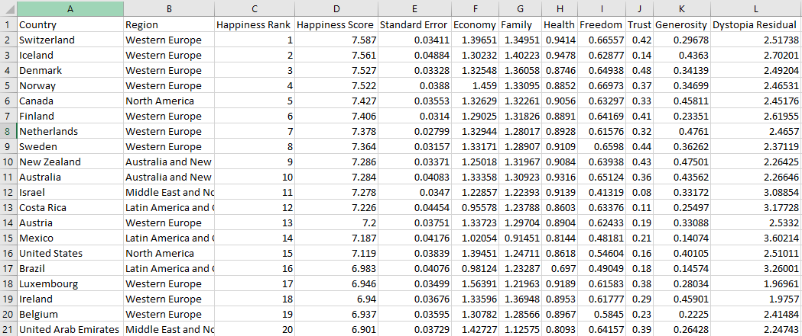
SAMPLE COLLECTION
Accessed from Kaggle. It contains separate csv files of happiness reports from the year 2015-2021.
This is an example of a sample from 2015

Slide 7
EDA.IPYNB
Exploratory Data Analysis
Machine Learning (Part 1)

Slide 8
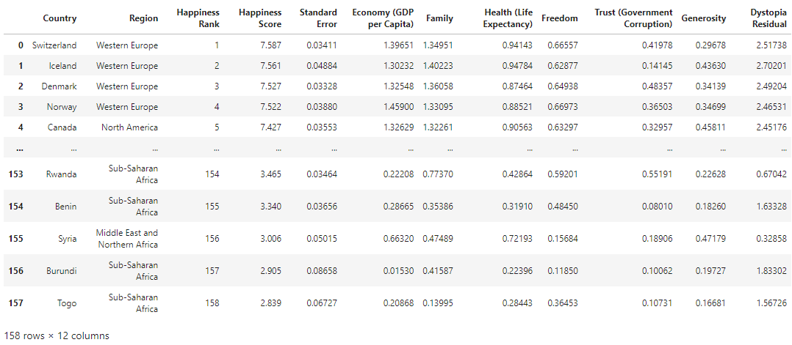
PRELIMINARY EDA ON YEAR 2015
Raw data for year 2015
Notes:
Mention number of rows and columns

Slide 9
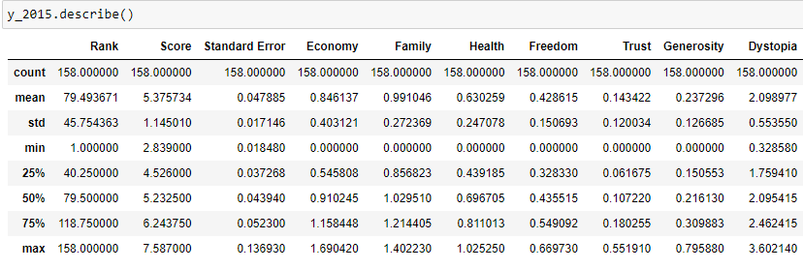
ANALYSIS OF RAW DATA
Not much difference between the mean and the median.
Only 7 numerical variables are required to predict the happiness score (Rank and Standard Error can be removed)
Notes:
We can observe that there is not much difference between the mean and the median of all the variables here. This shows that there are not many outliers in the dataset.
There are only 7 variables that are required to predict the happiness score:
Economy, Family, Health, Freedom, Trust, Generosity and Dystopia.

Slide 10
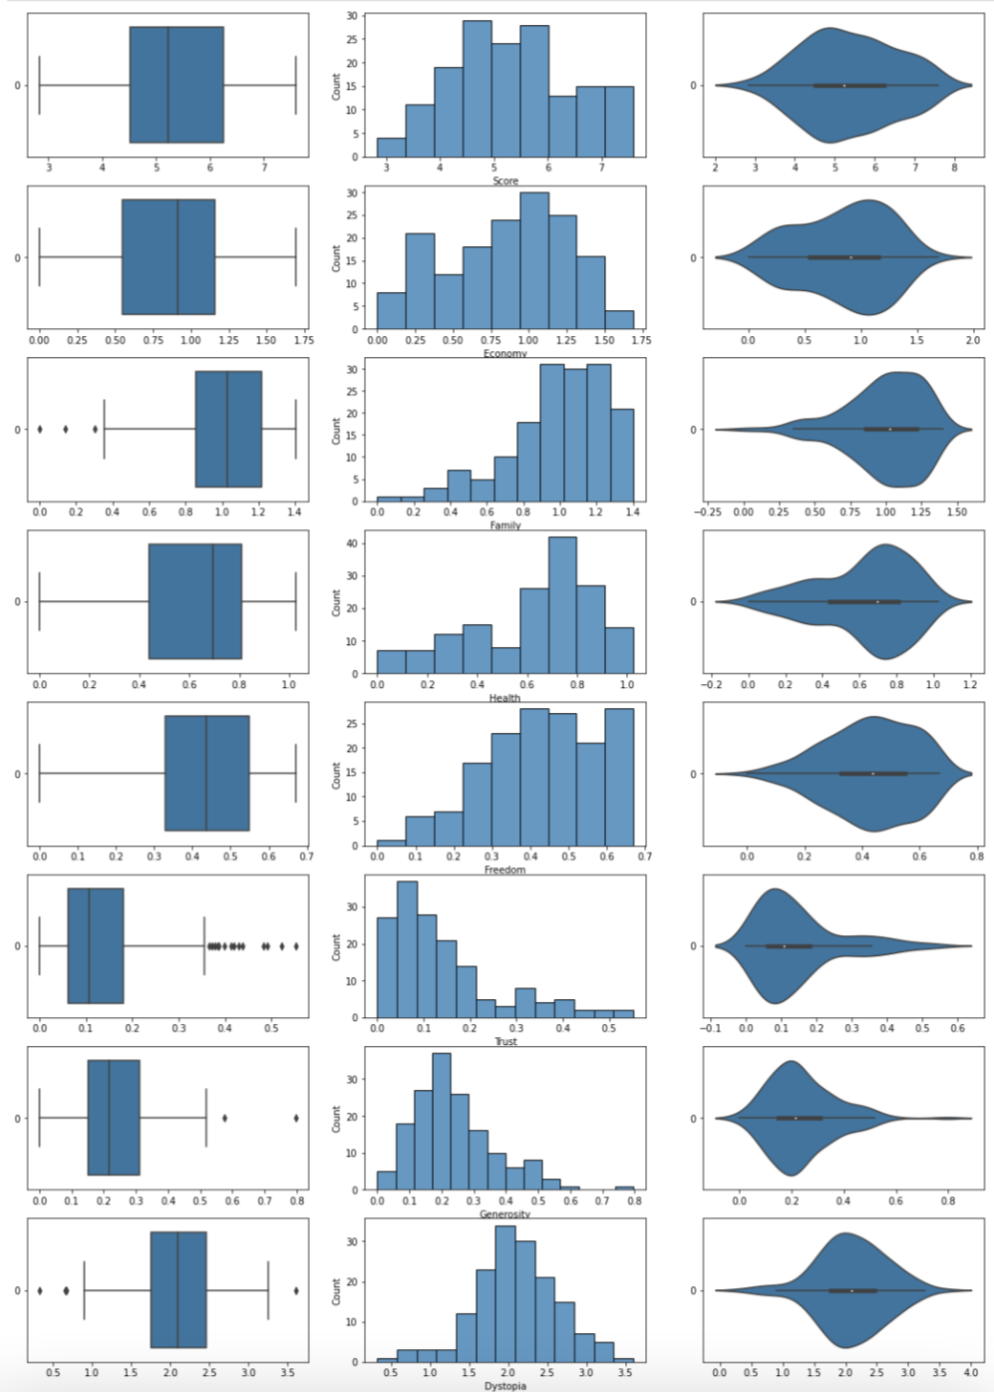
UNIVARIATE EXPLORATION
Fig: boxplot, histplot and violin plot for all variables is shown.
The median happiness score is just above 5.
Family, Health and Freedom all have positive skews.
Trust and Generosity has negative skews.
Trust has the most outliers, with a lot of data points exceeding the upper quartile.
Notes:
We plot the boxplot, histplot and violin plot for all variables.
The median happiness score is just above 5. Minimum score is around 3, so range (1,2) is not used.
Family, Health and Freedom all have positive skews. This could indicate that these variables are highly abundant in all countries.
Trust and Generosity has negative skews.
Trust has the most outliers, with a lot of data points exceeding the upper quartile. This indicates that there is a big group of countries that have high trust despite the rest of the world having low trust.

Slide 11
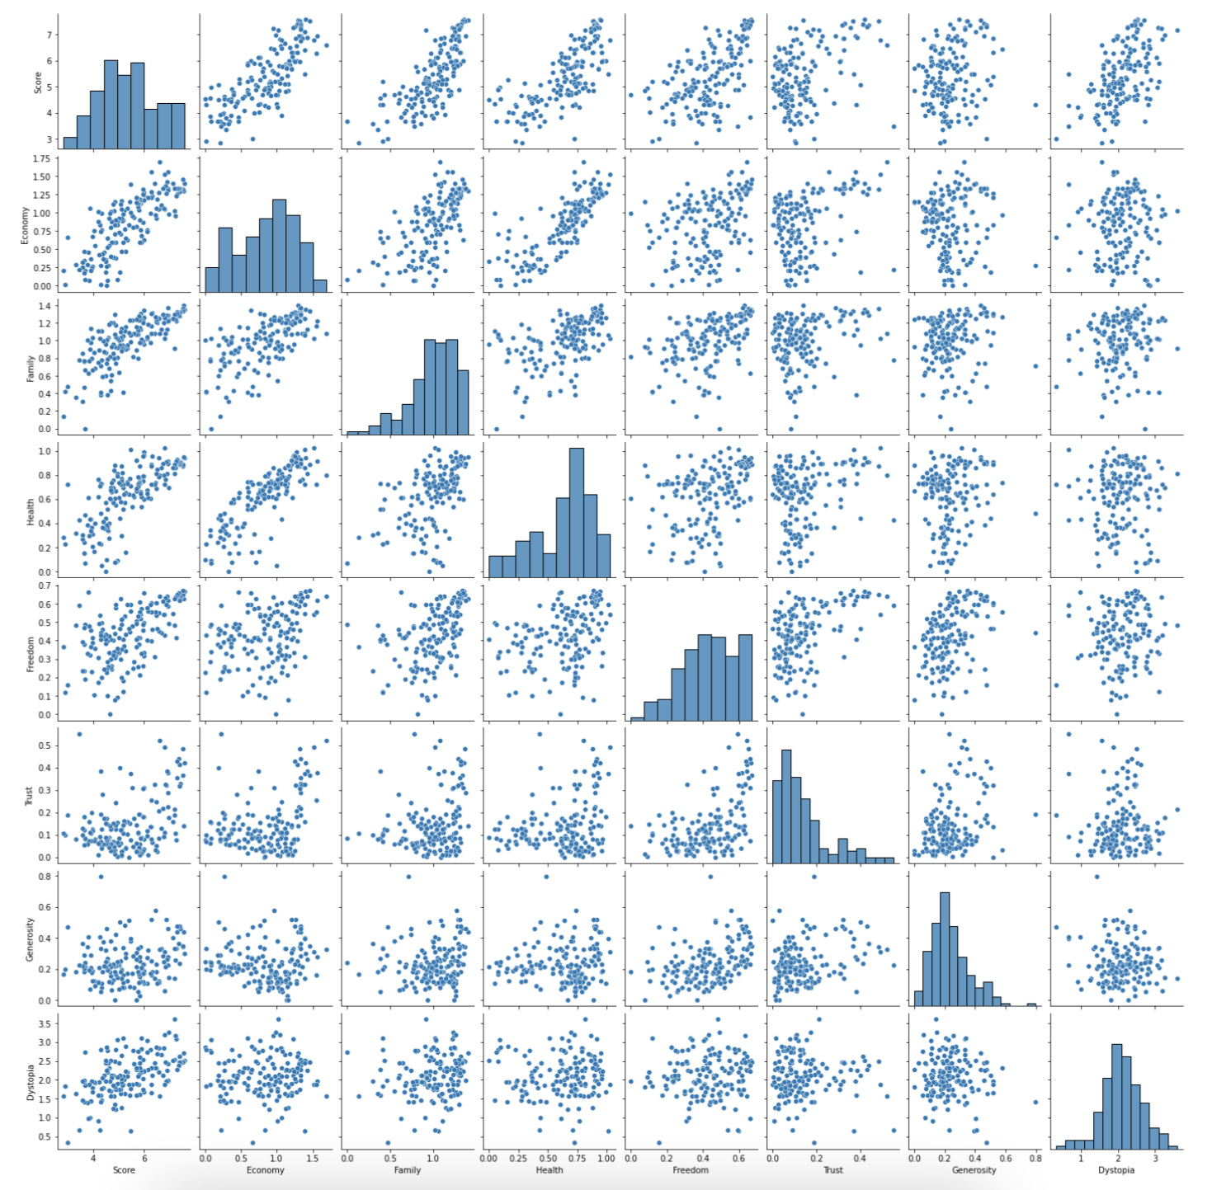
BIVARIATE EXPLORATION
Fig: Pairplot of all the variables in the new dataset.
Economy, Family and Health and Freedom have the highest correlation coefficients.
Variables with positive skew seem to have good correlation.
Generosity is a bad factor when predicting score.
Notes:
This is a pairplot of all the variables in the new dataset.
As we can see, Economy, Family and Health and Freedom have the highest correlation coefficients. These are the most important variables in predicting score.
An interesting observation is that the variables with positive skew seem to have good correlation, perhaps this is why the minimum score is 3 and mean, median are over 5.
At the same time, we can see that generosity is a bad factor when predicting score.

Slide 12
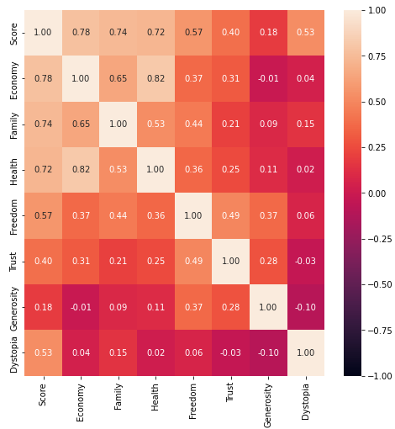
CORRELATION MATRIX
High correlation coefficient
Low correlation coefficient
Notes:
Mention low and high correlation, and how a factor like generosity may not be an important factor

Slide 13
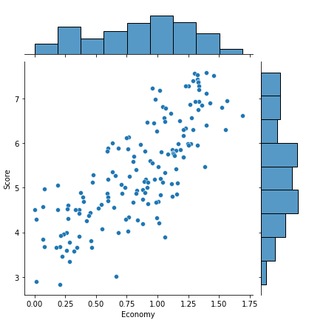
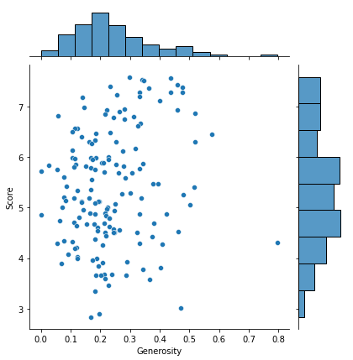
BEST V/S WORST
Highest Correlation: Economy
Lowest Correlation: Generosity
Notes:
Mention that it is a joint plot

Slide 14
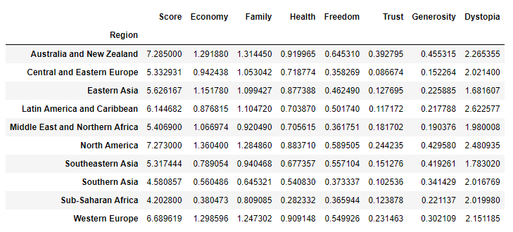
REGIONAL ANALYSIS
Asian and African regions are not as happy as the Western regions.
Exceptions:
Middle East and Northern Africa region.
Notes:
We can see that the Asian and African regions are not as happy as the Western regions.
Also, an exception to is Middle East and Northern Africa region, which has quite good economy but do not have a good happiness score.
This shows us there are factors which when combined cause more effect that the economy on the happiness of the country.
A fact to think about is that North America has a very high happiness score but a very high dystopia score at the same time

Slide 15
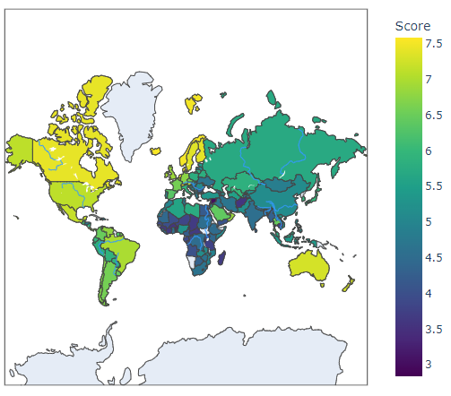
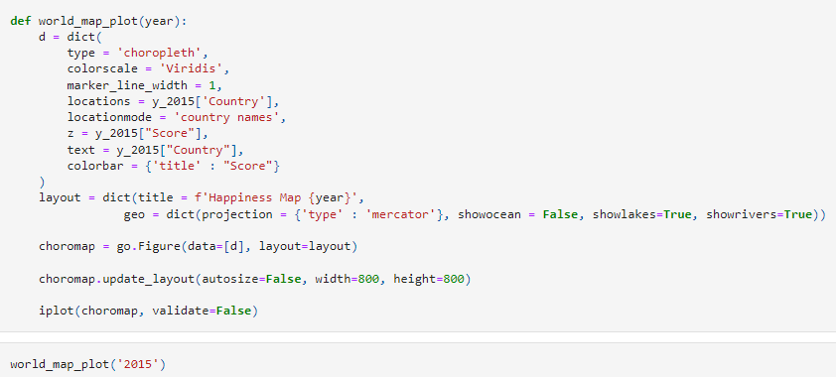
PLOTTING USING PLOTLY
Notes:
We can observe that the left side of the map has much higher happiness score than the right side. This may be due to the difference in culture or the grading of happiness being more favourable toward the West.

Slide 16
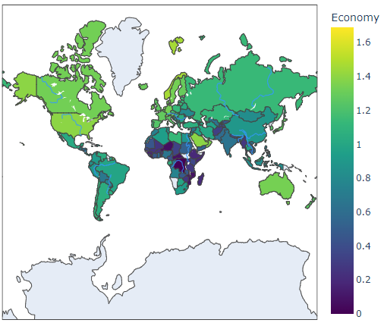
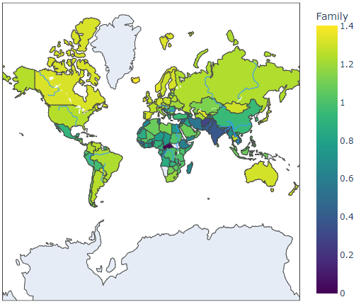
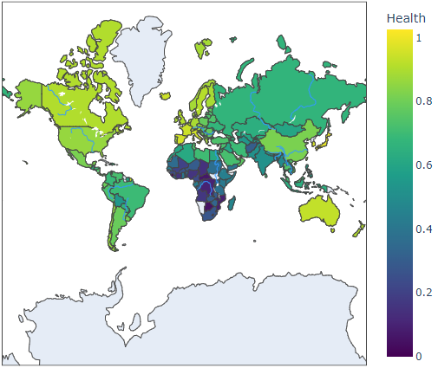
THE TOP 3 VARIABLES
North America is consistently bright and Africa is consistently dark.
These are the regions with highest and lowest mean happiness scores.
The variables with positive skew produce brighter maps while those with negative skew produce much darker maps.
Notes:
North America is consistently bright and Africa is consistently dark. This makes sense as we saw in the data analysis above, because these are the regions with highest and lowest mean happiness scores.
Also, the variables with positive skew produce brighter maps while those with negative skew produce much darker maps.

Slide 17
OVERVIEW OF REGRESSION MODELS
1. Linear Regression with K-Fold Cross Validation
2. Random Forest Regression
3. Gradient Boosting Regression
4. Ridge Regression
5. Huber Regression

Slide 18
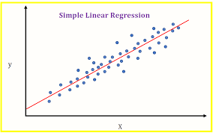
What is Linear Regression?
Simple linear regression is used to estimate the relationship between two quantitative variables.
The regression model obtained is of the type: y= a*x+b , which is basically the equation of a line.
Notes:
Mention that we use will be exploring different types of regression when predicting score.

Slide 19
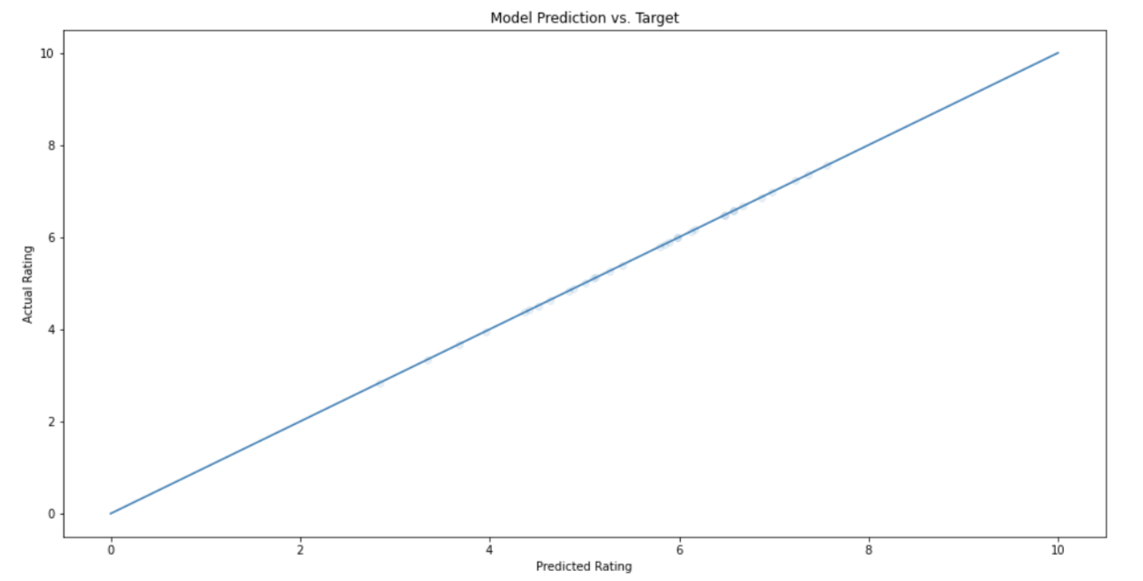
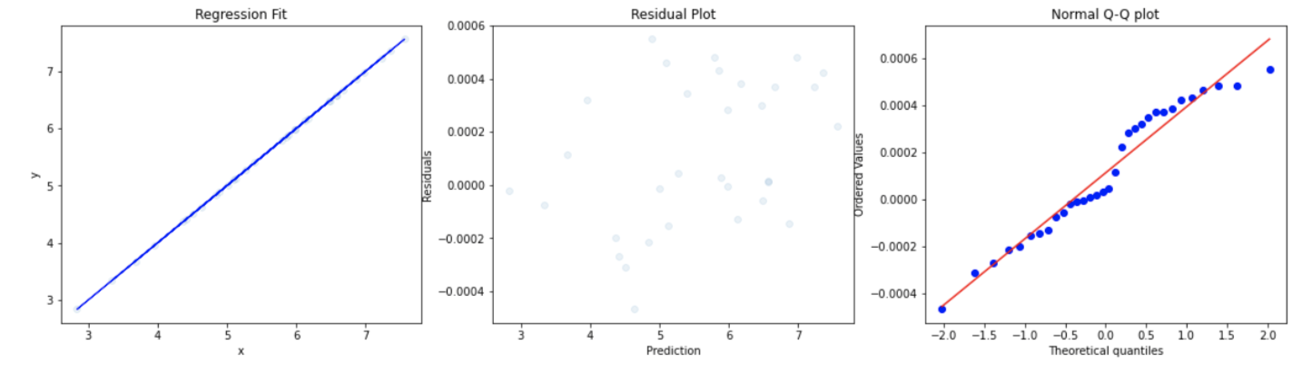
1. LINEAR REGRESSION WITH K-FOLD CROSS VALIDATION
K-Fold cross validation repeats the linear model on multiple train-test splits and averages it in order to find the average fit.
Linear Regression R^2 (train): ~ 1.000
Linear Regression R^2 (test): ~ 1.000
Linear Regression MSE (test): ~ 0.000
Linear Regression RMSE (test): ~ 0.000
Intercept of regression: 0.000172
Notes:
K-Fold cross validation repeats this linear model on multiple train-test splits and averages it in order to find the average fit.
Take note that R^2 and MSE are not actually 1 and 0, but instead close to 1 and 0, hence numpy had rounded it up. Could be because the data is a linear model in reality, hence the high accuracy.

Slide 20
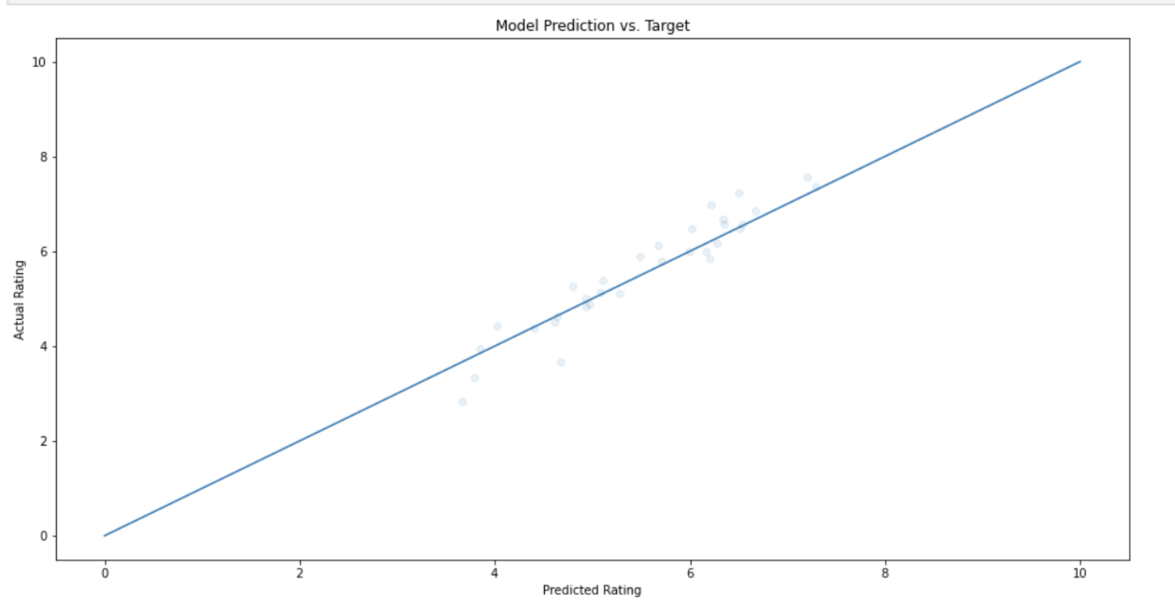
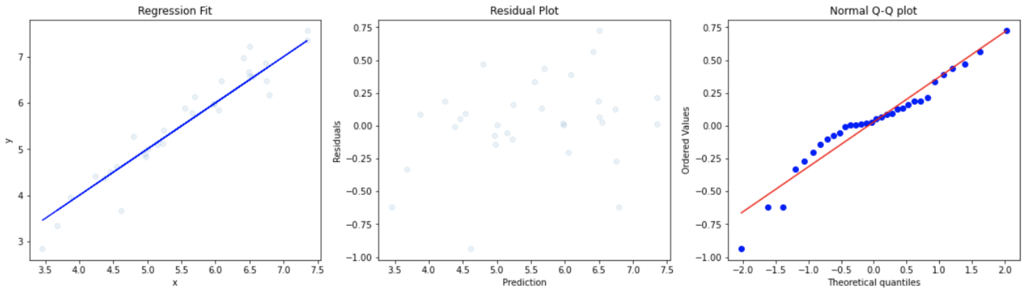
2. RANDOM FOREST REGRESSION
Random Forest fits a number of classifying decision trees on various sub-samples of the dataset and uses averaging to improve the predictive accuracy and control over-fitting.
Random Forest Regressor R^2 (train): 0.879
Random Forest Regressor R^2 (test): 0.585
Random Forest Regressor MSE (test): 0.145
Random Forest Regressor RMSE (test): 0.380
Notes:
Random Forest fits a number of classifying decision trees on various sub-samples of the dataset and uses averaging to improve the predictive accuracy and control over-fitting

Slide 21
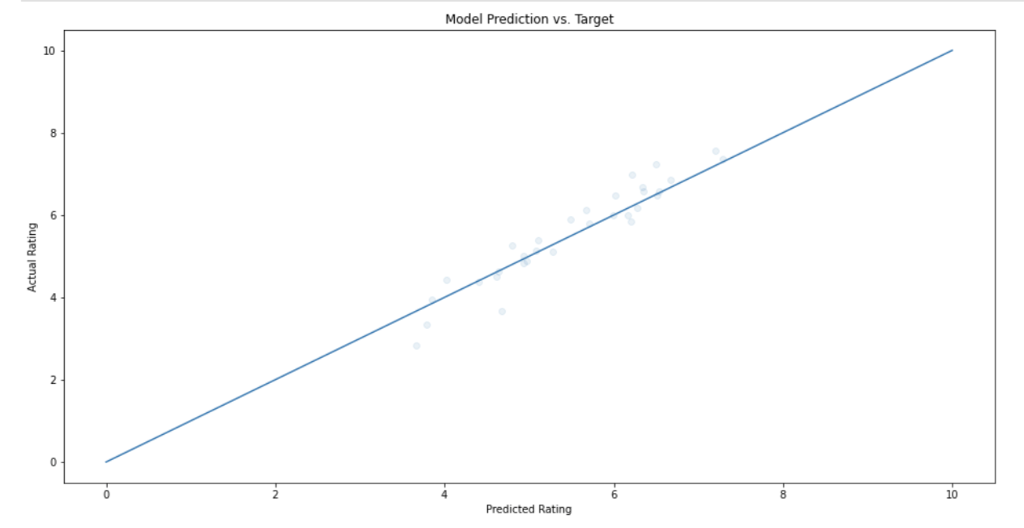
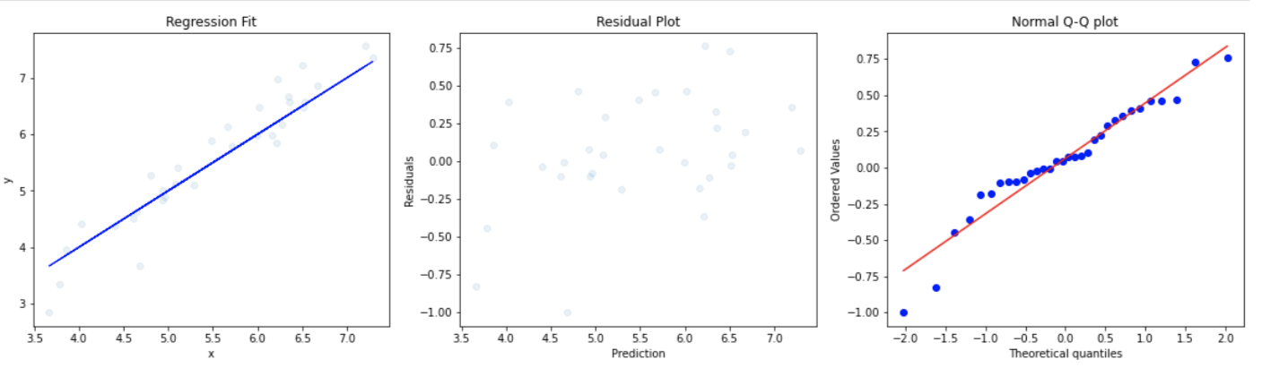
3. GRADIENT BOOSTING REGRESSION
Gradient Boosting uses a loss function to be optimized, a weak learner to make predictions, and an additive model to add weak learners to minimize the loss function.
Gradient Boosting Regression R^2 (train): 0.899
Gradient Boosting Regression R^2 (test): 0.586
Gradient Boosting Regression MSE (test): 0.114
Gradient Boosting Regression RMSE (test): 0.337
Notes:
Gradient Boosting uses a loss function to be optimized, a weak learner (eg. decision trees) to make predictions, and an additive model (gradient descent) to add weak learners to minimize the loss function.

Slide 22
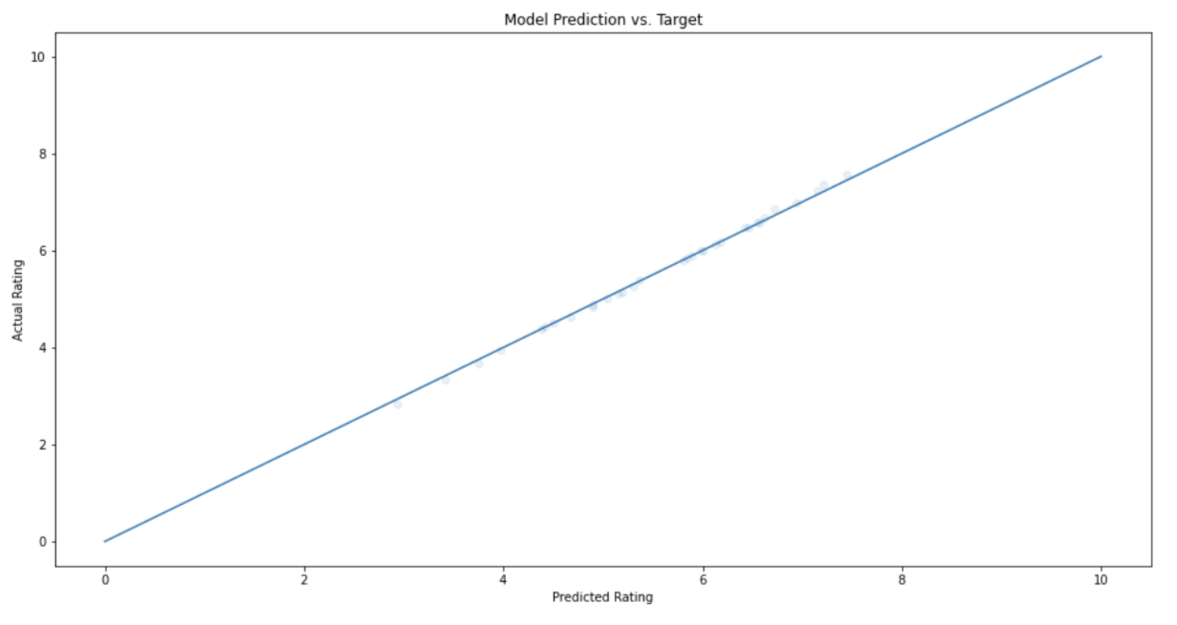
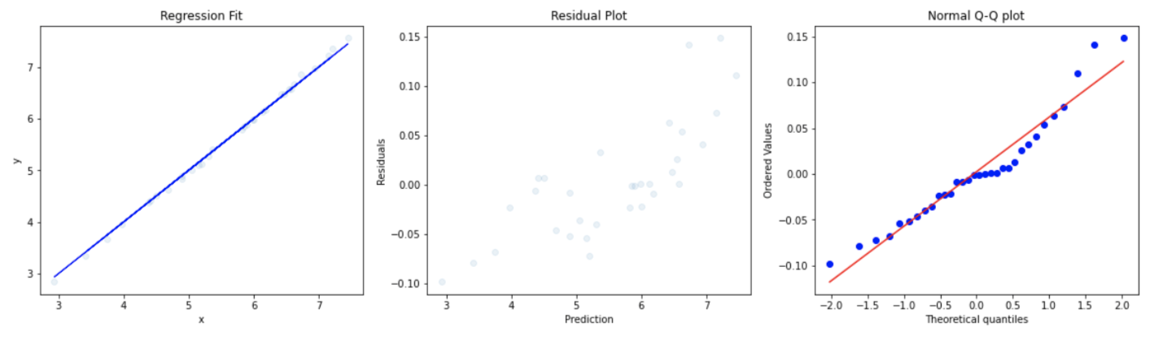
4. RIDGE REGRESSION
Ridge regression estimates the coefficients of multiple-regression models in scenarios where linearly independent variables are highly correlated.
Ridge Regression R^2 (train): 0.995
Ridge Regression R^2 (test): 0.947
Ridge Regression MSE (test): 0.003
Ridge Regression RMSE (test): 0.058
Notes:
Ridge regression is a method of estimating the coefficients of multiple-regression models in scenarios where linearly independent variables are highly correlated. It does this through linear least squares with l2 regularization top minimise the objective function.

Slide 23
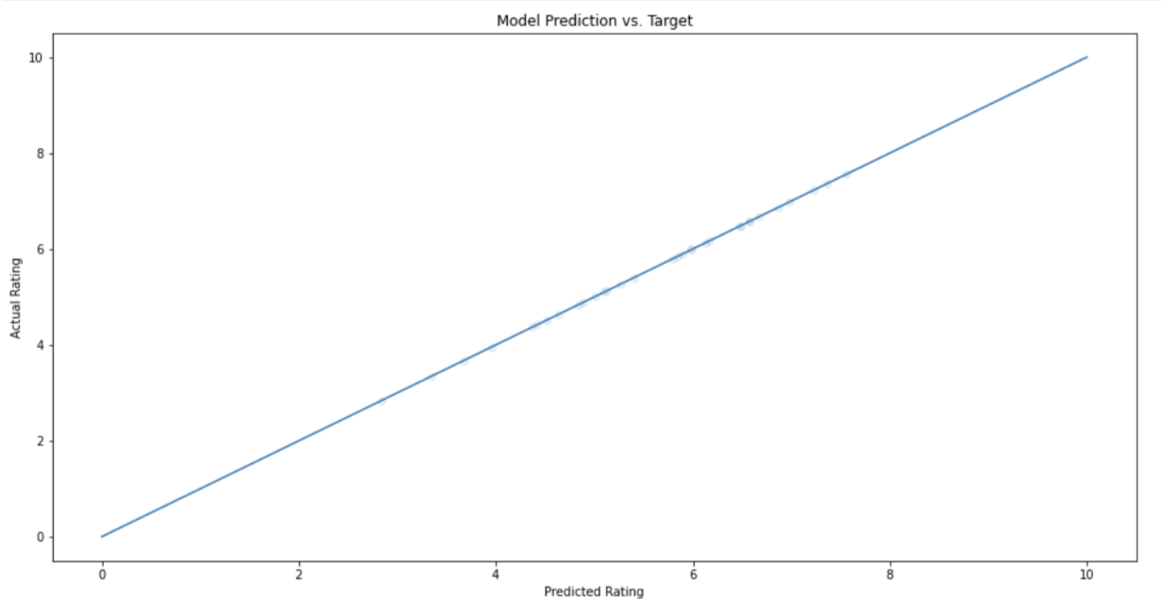
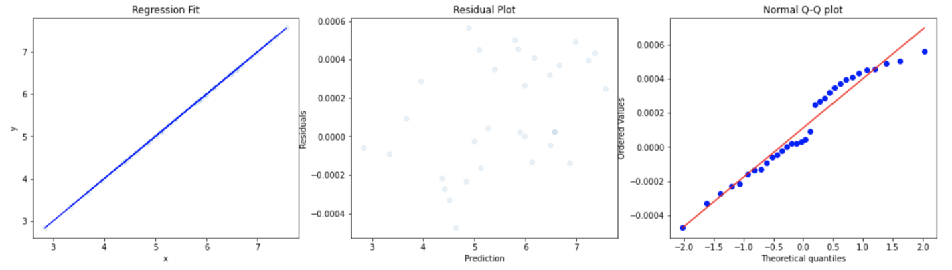
5. HUBER REGRESSION
Huber regression is a linear regression model that is robust to outliers and uses the Huber loss function, which makes sure that the loss function is not heavily influenced by the outliers while not completely ignoring their effect.
Huber Regression R^2 (train): ~1.000
Huber Regression R^2 (test): ~1.000
Huber Regression MSE (test): ~0.000
Huber Regression RMSE (test): ~0.000
Notes:
Huber regression is a linear regression model that is robust to outliers and uses the Huber loss function, which makes sure that the loss function is not heavily influenced by the outliers while not completely ignoring their effect.
Mention that accuracy is similar to linear regression score (will be explained in next slide)

Slide 24
CONCLUSION ON REGRESSION MODELLING
Regression Model | R^2 (train) | R^2 (test) | MSE (test) | RMSE (test)
Linear Regression | ~1.00 | ~1.00 | ~0.00 | ~0.00
Random Forest Regression | 0.879 | 0.585 | 0.145 | 0.380
Gradient Boosting Regression | 0.899 | 0.586 | 0.114 | 0.337
Ridge Regression | 0.995 | 0.947 | 0.003 | 0.058
Huber Regression | ~1.00 | ~1.00 | ~0.00 | ~0.00
Going off MSE and R^2 values, Huber and Linear regression seem to be the best model for our data.
The other models, although useful in theory, could be ineffective on our dataset as our data set only has 157 rows, which is rather low.
Notes:
Going off MSE and R^2 values, Huber and Linear regression seem to be the best model for our data as they have the lowest MSE and highest R^2. The other models, although useful in theory, could be ineffective on our dataset as our data set only has 157 rows, which is rather low.
Huber and Linear regression has similar values because Huber regression takes into account outliers, but our data does not have any, thus it is just a normal linear regression
We have decided that Huber Regression is the best model for our data as it takes into account outliers in the data that may exist, while Linear Regression does not.
Going forward, we will be making use of Huber Regressor when predicting future Happiness Score in the next notebook: machine_learning

Slide 25
CLEANING.IPYNB
Data preprocessing
Data cleaning
Data exporting

Slide 26
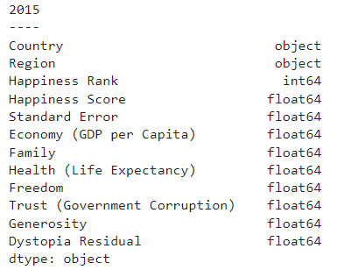
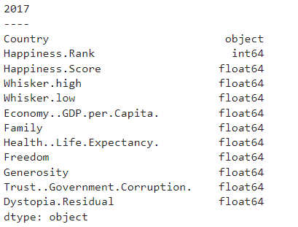
DATA CLEANING FOR TIME SERIES
This shows the uncleaned raw data for 2015 and 2017 (as an example)
We can observe that not all columns are the same. Can observe the same thing for the other years too.
Notes:
We need to merge the data from 2015-21 and for that cleaning of dataset is required.

Slide 27
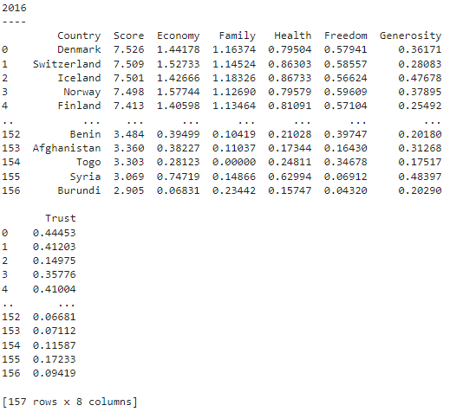
CLEANING THE COLUMNS
After cleaning, we are left with these columns
We have removed ‘Rank’ for now.
Now the datasets have same columns but number of rows are still different.
Notes:
Datasets do not have the same rows and columns.
We rename the columns and remove a few to make all the columns same in all datasets.
Here is the example of 2016 dataset after renaming and cleaning.
Remove ‘Rank’ for now. (Reasoning is because we are removing some rows later, and rank will end up changing)
Now the datasets have same columns but number of rows are still different.
From above, we can see that the datasets do not have the same rows and columns. Following are the steps we follow:
Some variables are also named slightly differently in each dataset. SO, we clean the columns first.
Based on our observations, the columns we renamed and decided to keep are:
Country
Score
Economy
Family
Health
Freedom
Generosity
Trust
We remove ‘Rank’ column for now, because it changes when we remove some unnecessary rows. We reintroduce it later.

Slide 28
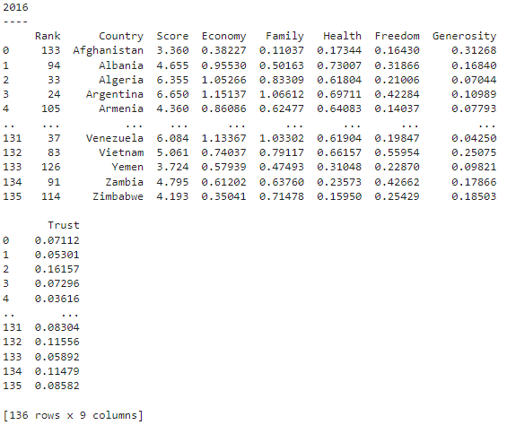
CLEANING THE ROWS
Each dataset has different number of rows.
We keep only the countries which are included in all datasets.
We reintroduce the Rank column.
Ending shape: 136 rows and 9 columns
Notes:
Each column has different number of rows, because some countries do not appear in all datasets.
Therefore, we keep only the countries which are included in all datasets.
Also, we reintroduce the Rank column.
We are left with 136 rows and 9 columns for each dataset.

Slide 29
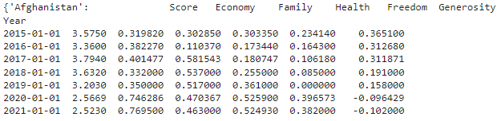
CONVERTING TO TIME SERIES
Now, we will be converting our data to time series
This is to help us do time series regression.
There will only be one time series for each country.
Here is the example of Afghanistan being converted to time-series:
Notes:
In total, we have created 135 time series.

Slide 30

EXPORT THE DATA
Now, we have finished our cleaning.
We will be using this data in the next notebook.

Slide 31
MACHINE_LEARNING.IPYNB
Machine Learning (Part 2)
Recommendations

Slide 32
OVERVIEW OF MODELS
1. Autoregression on Score
2. Autoregressive Integrated Moving Average(ARIMA) on Score
3. AR/ARIMA on Variables followed by Huber Regression

Slide 33
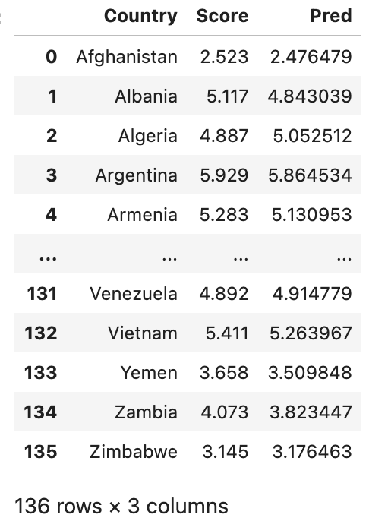
1. AUTOREGRESSION ON SCORE
Autoregression is a time series model that uses observations from previous time steps as input to a regression equation to predict the value at the next time step.
Autoregression Predictions
Mean Squared Error (MSE) = 0.0000233633
Applying autoregression with a time lag of 1 from years 2015-2020 to predict 2021 data has worked and yielded results, with a very low MSE.
Notes:
On applying Autoregression on Score we can see the predicted values column.
Autoregression is a time series model that uses observations from previous time steps as input to a regression equation to predict the value at the next time step. These steps are called lag. For our time series, we will be using lag of 1 to train our model. Although larger lag is recommended, we have to compromise due to having small number of data points.
As we can see, applying autoregression with a time lag of 1 from years 2015-2020 to predict 2021 data has worked and yielded results, with a very low MSE. Let us try ARIMA now and see if it can produce better results!

Slide 34
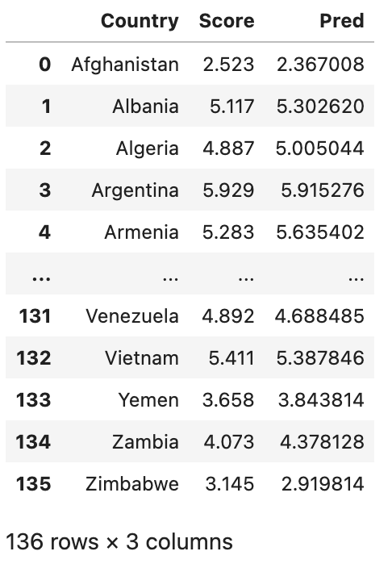
2. ARIMA ON SCORE
ARIMA combines autoregressive features with those of moving averages.
ARIMA Predictions
Mean Squared Error (MSE) = 0.0005558669
Although ARIMA is also a good model as it has a really low MSE, Autoregression still yields better results with lower MSE.
This could be due to our dataset not having enough entries, thus we do not make use of the advantage of ARIMA, being able to predict and observe sub trends.
Notes:
ARIMA combines autoregressive features with those of moving averages. A moving average is a calculation used to analyze data points by creating a series of averages of different subsets of the full data set in order to smooth out the influence of outliers. As a result of this combination of techniques, ARIMA models can take into account trends, cycles, seasonality, and other non-static types of data when making forecasts.
Although ARIMA is also a good model as it has a really low MSE, Autoregression still yields better results with lower MSE. This could be due to our dataset not having enough entries, thus we do not make use of the advantage of ARIMA, being able to predict and observe sub trends. However, in the long run, I believe ARIMA may be the better model, if the time series exceeds 100+ entries.
Going forward, we will be using Autoregression instead of ARIMA due to the nature of our dataset.

Slide 35
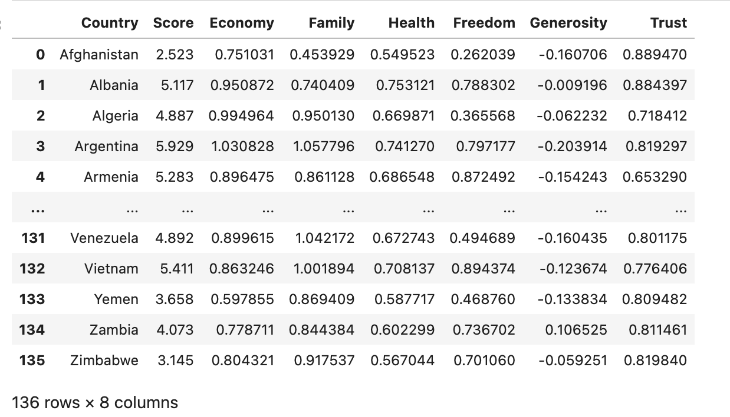
3. AUTOREGRESSION ON VARIABLES
Instead of performing autoregression directly on score, we do auto regression on variables.
This would give us the dataset with predicted values for 2021.
The next step would be to apply Huber Regression :
Train dataset: 2020 data
Test dataset: 2021 predicted variable data

Slide 36
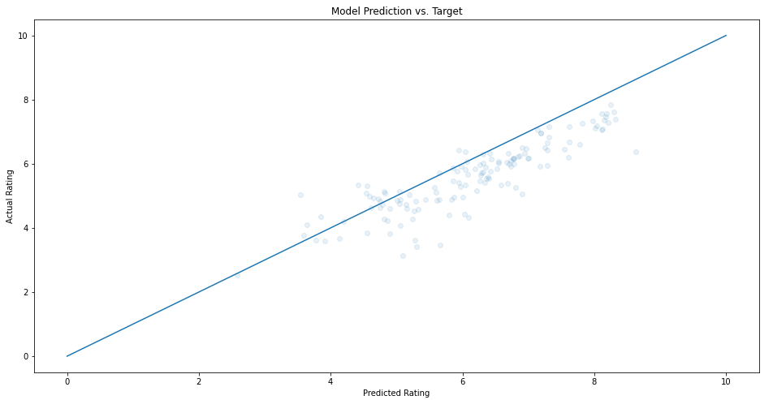
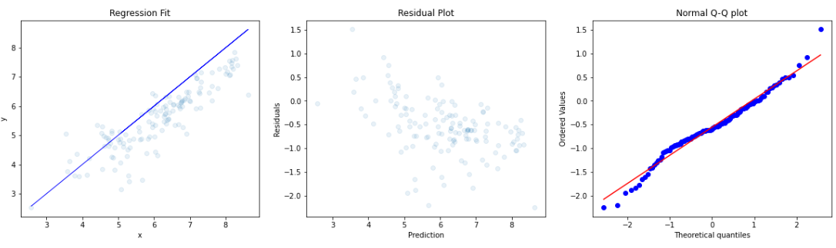
APPLYING HUBER REGRESSION
We apply huber regression on the variable values predicted through autoregression to get the predicted Score values for 2021.
Huber Regression R^2 (train): 0.675
Huber Regression R^2 (test): 0.735
Huber Regression MSE (test): 0.655
Huber Regression RMSE (test): 0.809
We get bad MSE and R^2 values.

Slide 37
STATISTICAL INFERENCE

Slide 38
CONCLUSION
On applying Huber regression, we get bad MSE and R^2 values. This may be because the linear model or equation in the 2021 dataset used to calculate Happiness Score being slightly different from 2020's one.
It may not be feasible to use this method to predict future scores. However, it may still be useful to do this just to see what the forecasted values of the variables will be in the future.
Factors that are important and lead to a higher happiness score.
They can make use of this in order to figure out which part of their country to focus on first in order to see immediate results.
They will also be able to forecast future variables (ceteris paribus) and also the forecast of future score. Using this, they can selectively see which part of the country may need improvement the most.
Notes:
On applying Huber regression, we get bad MSE and R^2 values. This may be because the linear model or equation in the 2021 dataset used to calculate Happiness Score being slightly different from 2020's one.
This means that it may not be feasible to use this method to predict future scores. However, it may still be useful to do this just to see what the forecasted values of the variables will be in the future.
Overall, this series of notebooks has allowed us to see exactly how a governing body can analyse and break down which factors are important and lead to a higher happiness score.
They can make use of this in order to figure out which part of their country to focus on first in order to see immediate results.
They will also be able to forecast future variables (ceteris paribus) and also the forecast of future score. Using this, they can selectively see which part of the country may need improvement the most.

Slide 39
RECOMMENDATION - DATASET
The data set is small. More data!
Data is not inclusive .
Not all factors are included in the dataset.
Example: The quality of transport, educational institutes, job satisfaction, unemployment, etc
We have non-measurable data.
Regions should’ve been classified according to the continent.
Notes:
The data set is small. A few more years worth of data would have got us better results.
Data is not inclusive (A few countries have been left out). The survey should have been done in all countries.
Not all factors are included in the dataset. There are many other things that may affect the happiness of a country, but are not taken as variables.
Example: The quality of transport, educational institutes, job satisfaction, unemployment, etc
We have non-measurable data. It is difficult to measure factors like happiness in form of numbers in real life.
What we can do is use data like number of colleges, number of roads per square feet, number of jobs, unemployment rate, ie, numerical data to predict the happiness report instead of putting values on variables like trust.
Regions should’ve been classified according to the continent so that they we could perform a geographic plot based on happiness too. For example, instead of Australia and New Zealand, it should be just Australia.

Slide 40
RECOMMENDATION - MODEL
Use of VAR (Vector Autoregression) instead of using AR and Hubert regression to directly forecast the value of Score for 2021.
VAR is a multivariate forecasting algorithm that is used when two or more time series influence each other.
Time series had only 7 entries.
Best model theoretically.
Notes:
Can use VAR instead of using AR and Hubert regression to directly forecast the value of Score for 2021.
VAR is a multivariate forecasting algorithm that is used when two or more time series influence each other. For our data, certain variables such as Trust, may affect other variables, such as Freedom.
Our team has tried to implement VAR on our time series, however, we were unable to do so as the time series only had 7 entries and hence only lag of 0 could be used (which is just linear regression). In order to implement this, we need more data entries for world happiness statistics, which is unavailable.
However, in theory, we believe that the VAR model will be the most effective in predicting score, as there is strong relationship between some variables to other variables. Thus, if given the opportunity, we would have loved to try out VAR and compare it with the other models.

Slide 41








LIBRARIES USED

Slide 42
Thank You!

Slide 43
Oak Soe Khant
Code Refactoring, EDA, Data Cleaning, Machine Learning Models, Slides, Video Editing
Sisodia Anushka
EDA, Slides, Presentation
Oza Tirth Tusharbhai
EDA, Slides, Presentation
PROJECT CONTRIBUTIONS

Slide 44
REFERENCES
https://www.kaggle.com/datasets/mathurinache/world-happiness-report
https://plotly.com/python/choropleth-maps/
https://machinelearningmastery.com/k-fold-cross-validation/
https://www.analyticsvidhya.com/blog/2016/02/complete-guide-parameter-tuning-gradient-boosting-gbm-python/
https://www.machinelearningplus.com/time-series/arima-model-time-series-forecasting-python/
https://www.machinelearningplus.com/time-series/vector-autoregression-examples-python/
https://towardsdatascience.com/regression-in-the-face-of-messy-outliers-try-huber-regressor-3a54ddc12516
https://towardsdatascience.com/ridge-and-lasso-regression-a-complete-guide-with-python-scikit-learn-e20e34bcbf0b
https://towardsdatascience.com/machine-learning-basics-random-forest-regression-be3e1e3bb91a

